Slide 1
A Statistical Approach to Measuring User Authenticity
Lin Du

Slide 2
Password
Weak and outdated
Over the course of March, 2016–March, 2017, we identify 788,000 potential victims of off-the shelf keyloggers; 12.4 million potential victims of phishing kits; and 1.9 billion usernames and passwords exposed via data breaches and traded on black market forums.
Reference: Data Breaches, Phishing, or Malware? Understanding the Risks of Stolen Credentials
https://storage.googleapis.com/pub-tools-public-publication-data/pdf/bdc662fba6ebc6b784e2b0a22536e942a16221af.pdf

Slide 3
MFA-2FA
The industry categorizes the factors into three buckets: something you know, have or are. Something you “know” would be things like your favorite color, a password, a PIN, or a one-time password. Something you “have” includes things like special hardware, a digital certificate, a smart card or device containing a digital certificate. And something you “are” is your face, fingerprint, or heartbeat.
And 2FA is just the bare minimum MFA option, using just two elements. This second factor is typically a hardware token, an authentication app, or a mobile phone number or an email address. Most major websites (e.g. Google, Facebook, LinkedIn, and Twitter) now offer a two-factor authentication solution.
Reference: https://www.geekwire.com/2018/digital-authentication-human-beings-history-trust/

Slide 4
However, two-factor authentication, being an opt-in process, suffers from low adoption rates and does little to thwart a large-scale attack on an Internet service. this level of friction would be highly detrimental to the site’s level of engagement, as a large percentage of legitimate users will be unwilling or unable to solve these challenges. There is thus a need to classify the level of suspiciousness of any authentication attempt and only block or challenge the most suspicious.
Biometric authentication techniques, including fingerprint and face recognition and typing dynamics, have also been investigated as an alternative to password-based authentication, but limited performance on very large numbers of users and risks for privacy leaks have actually slowed down its adoption in large online services.
Reference: Who Are You? A Statistical Approach to Measuring User Authenticity
http://theory.stanford.edu/~dfreeman/papers/ato-model.pdf

Slide 5
A statistical classification method
The classification of login attempts (e.g., into three tiers good/suspicious/bad) is derived from the data available at the time of the login, including source IP address, geo-location, operating system and browser configuration, the account’s patterns of usage, and more.

Slide 6
Began with a likelihood ratio test and show how the desired ratio can be approximated in the presence of sparse data.
Smoothing techniques was performed to handle cases where there is no data, such as when a user logs in from a previously unseen IP address.
Validate the proposal on a sample of real-life user login data from LinkedIn; Used six months of history and only two features (IP address and useragent); achieve AUC 0.96 and find that the most suspicious 10% of login attempts include 89% of labeled account takeover attempts.

Slide 7

U is a given user account, X is a d-dimensional set of feature values characterizing a login attempt (e.g., timestamp, IP address, browser, etc.)
Y = $\left\{A,L\right\}$ the class label of legitimate login (L) or attacks(A)

Slide 8

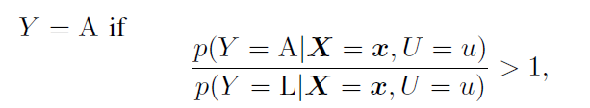

(1)
(2)
(3)

Slide 9
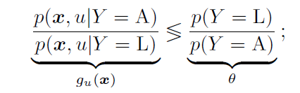
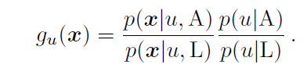



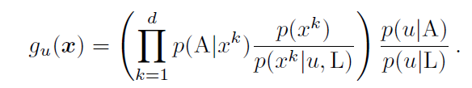
(4)
(5)
(6)

Slide 10
p(u|A). This is the probability that user u is attacked, given that we observed an attack. Since we may not have enough data to estimate this probability in a reliable manner, it may be entirely reasonable to assume that all users are equally likely to have their password compromised;
p(A|x). Ideally, one may obtain this probability for every feature value x from the training data. In practice, there are not sufficient examples of attacks for each x, so we can use reputation systems as proxies. These may be built internally from sitewide abuse data (i.e., not just account takeover attempts) or may be sourced from a third party (see, e.g., [54]). An IP reputation system will assign a “reputation score” to each IP address that indicates how likely the IP address is to be abusive.

Slide 11
p(u|L). This is simply the probability that user u is logging in to the site, given that the login is legitimate.
p(x); p(x|u; L). As a basic estimate we can compute the proportion of times in history that we have seen x as the value of feature X; this computation can be applied globally or on a per-user, class-conditional basis.

Slide 12
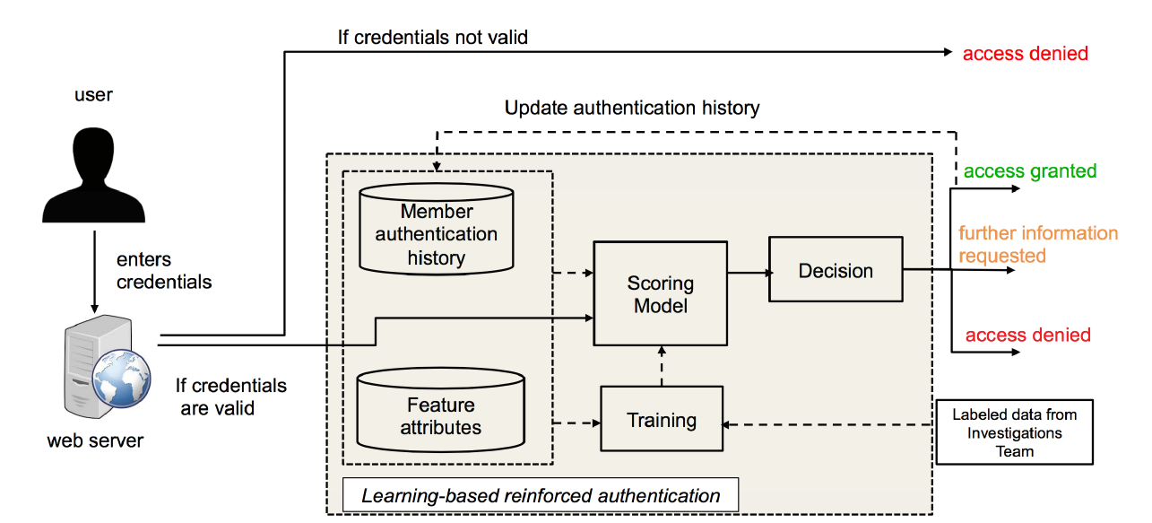

Slide 13
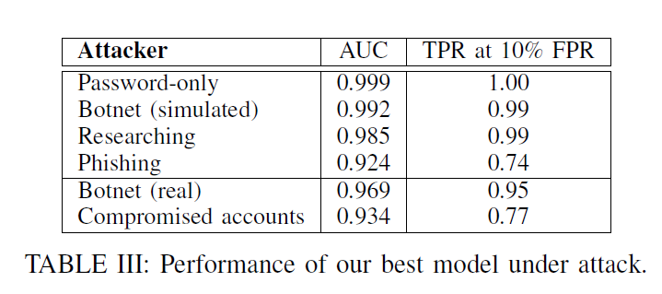

Slide 14
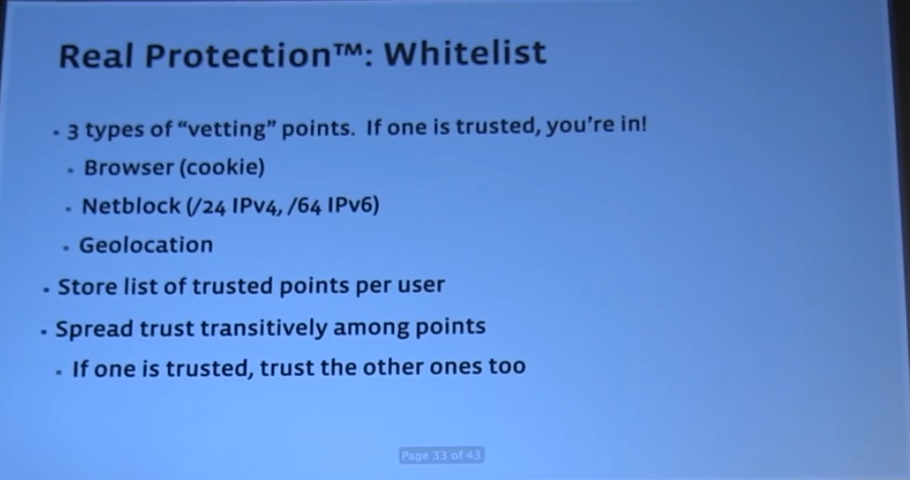
A Facebook example
Facebook engineer gives some idea about their system at the time, which uses a whitelist based on browser cookies, IP ranges, and geolocation, a blacklist based on several known attack patterns (such as many failed login attempts from an IP), and some undisclosed additional mechanisms.
Reference: https://vimeo.com/80460475

Slide 15
Ali pay
Device
Environment
Preference
Behavior
Relationship
Accounts
ID
transaction
Reference: https://mp.weixin.qq.com/s/Zo39NRA1YJUcTWclIe3XBA

